Slide 1
Employee Attrition & Sentimental Analysis
Made by: Abhishek Mishra

Slide 2
What is Employee Attrition?
Putting simply, employee attrition is the reduction of staff by voluntary or involuntary reasons. These can be through natural means like retirement, or it can be through resignation, termination of contract, or when a company decides to make a position redundant.

Slide 3
Objectives
This work aims in developing a Decision Support System in employee attrition detection that uses the data mining technique having best accuracy and performance among Support Vector Machine, KNN, and Random Forest etc.
By using several HR employee data management system parameters such as satisfaction level, last evaluation etc.
And finally, deploying the best model API.

Slide 4
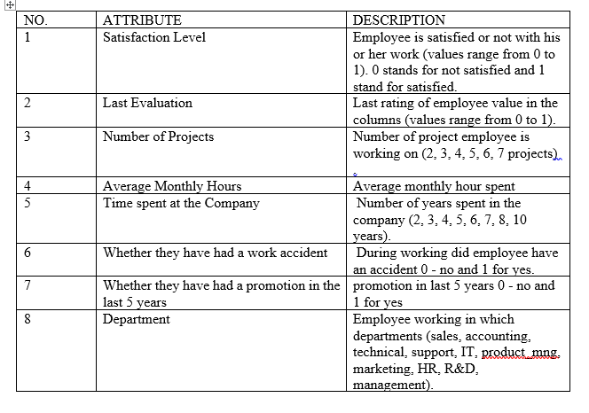
Data structure

Slide 5
Techniques Used
Random Forest
Decision Tree
KNN
SVM:

Slide 6
Outcomes
Technique Accuracy
SVM 95.54%
KNN 96.0%
Decision Tree 92.23%
Random Forest 98.9%

Slide 7
Conclusion
Through my analysis, managing the level of satisfaction is the key to keep employees with the firm.
This is especially important for employees who have been around for more than 3 years. Other than that the employee evaluation and number of projects should also be monitored.
This firm’s HR Head would do well to craft programs to keep tabs and these metrics so as to have a successful talent retention policy.

Slide 8
Recommendation
At, then end I would like the firm to adopt my ML API, as it will not only allow them to save cost due untimely quitting of job by an employee. But also able to retain them. And further this can be share with others companies or subsidiaries and prove to be commercial success.

Slide 9
Sentimental Analysis
Definition
Sentiment Analysis is the process of ‘computationally’ determining whether a piece of writing is positive, negative or neutral. It’s also known as opinion mining, deriving the opinion or attitude of a speaker.

Slide 10
OBJECTIVEs
This work aims at developing a system which tells us about the sentiment prevailing for the particular industries, product etc.
In this paper, I have used the random forest as the data mining technique and for visualization, I have applied “Word cloud”.
The dataset deals with the sentiments of people for US-based airlines industry.

Slide 11
Technique Used
Word Cloud: A tag cloud is a novelty visual representation of text data, typically used to depict keyword metadata on websites, or to visualize free form text. Tags are usually single words, and the importance of each tag is shown with font size or color.

Slide 12
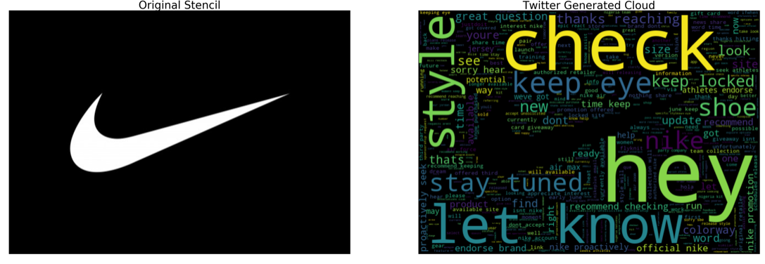
Word Clouds

Slide 13
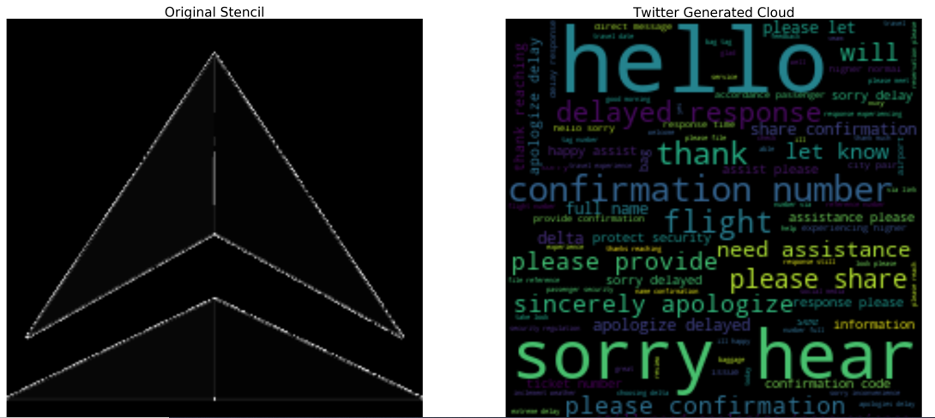
Delta Airways

Slide 14
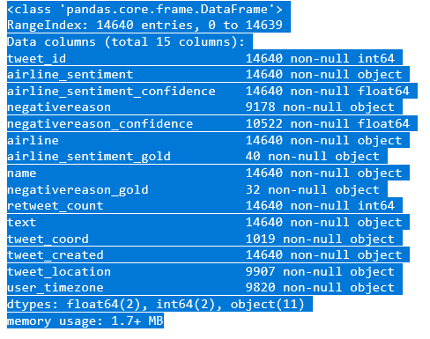
Data Structure

Slide 15
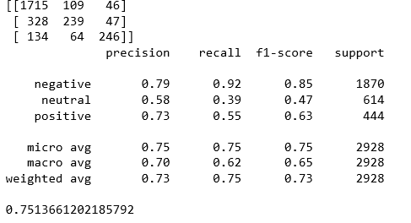
Findings
Random Forest

Slide 16
Conclusion & Recommendation
Thus, we can conclude that the negative sentiment about the particular industry is too high. Thus I would like to recommend the CEO (New comer) to make prior arrangement to tackle these unfavorable situation before entering into this market. And, in case the CEO is an existing player then he should try improve his grievance redressal system, so that he can take advantage existing situation and make profit in long run through taking the advantage of uniqueness

Slide 17

ANY QUESTIONS

